Slide 1
Supply Chain Management

Slide 2
Supply Chain Management - Introduction
Material B
Factory
1
Material A
Factory
2
The
Customer
(Retailer)
Factory
3
Material C
Factory
4
Factory
5

Slide 3
Overview of Supply Chain
“A Supply Chain is a global network of organizations that cooperate to improve the flows of material and information between suppliers and customers at the lowest cost and the highest speed. “
The supply chain-a network of organizations and business processes for acquiring the raw materials, transforming them into finished goods, and distributing the products to the customers. The supply chain links many business entities, such as supplier, manufacturer, transporter, distributor, retailer, and the customers themselves.
The supply chain is driven by three main inputs namely information, materials and funds which flow among the supply chain members.
The raw material sources from suppliers are transformed to intermediate products and finished goods through manufacturing facilities. The finished products are shipped to distribution centers and from there to retailers and ultimately to customers. However, the supply chains, especially of large manufacturers, can have primary, secondary, and tertiary suppliers also.
Note that the supply chains of different organizations may differ in the number of entities and it is not always required for a supply chain to have all the entities. Each entity in the supply chain contributes to the goal of reaching the customers.

Slide 4
Introduction to Supply chain management
What is supply chain?
Supply chain refers the entire network of companies that work together to design, produce, deliver and service products.
or A supply chain is a sequence of organizations - their facilities, functions and activities - that are involved in producing and delivering a product or service.
A value chain is another name for a supply chain.
Supply chain management (SCM) is a business and technology discipline that refers to the ways of coordinating the activities involved in purchasing, designing, building and selling a product.
SCM includes managing supply and demand, sourcing raw materials and parts, manufacturing and assembly, warehousing and inventory tracking, order entry and order management, distribution across all the channels, delivery to the customers.

Slide 5
Contd.
More definitions:
Supply chain management deals with the management of materials, information, and financial flows in a network consisting of suppliers, manufacturer, distributor and customers.
SCM involves “managing the flow of items, information, cash and ideas through the coordination of supply chain processes and through the strategic addition of place, period ad pattern values.”
Supply chain management is a set of approaches utilized to efficiently integrate suppliers, manufacturers, warehouses, and stores, so that merchandise is produced and distributed at the right quantities, to the right locations, and at the right time, in order to minimize system wide costs while satisfying service level requirements.

Slide 6
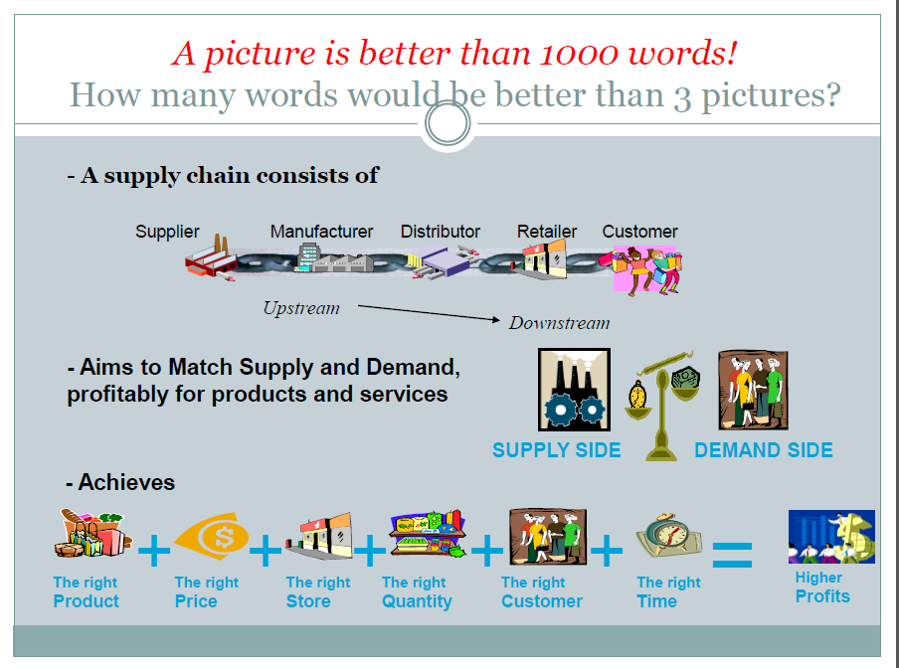

Slide 7
Objective of SCM
The various objectives of Supply Chain Management which are applicable for International Logistics and Supply Chain management.
1.To maximize overall value generated
2.To look for Sources of Revenue and Cost
3. Replenishment of the Material or Product whenever required
4. Quality Improvement
5. Shortening time to Order
6. To speedup the Market and maximize efficiency of distribution side
7. To meet consumer demand for guaranteed delivery of high quality and low cost with minimal lead time.
8. Helps in better decision
9. To achieve world class performance
10. More awareness of supply chain dynamics and efficiency
11. To fulfill customer demand through efficient resources
12. To optimize pre and post production inventory levels
13. Reduce transportation cost

Slide 8
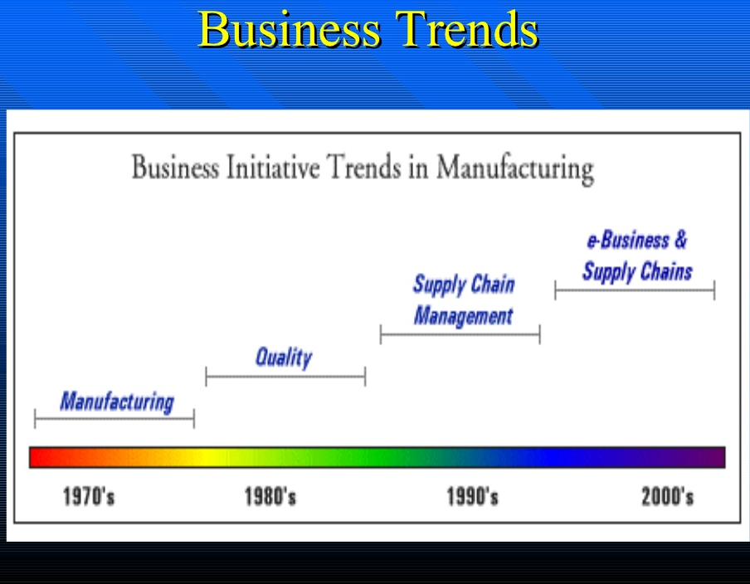

Slide 9
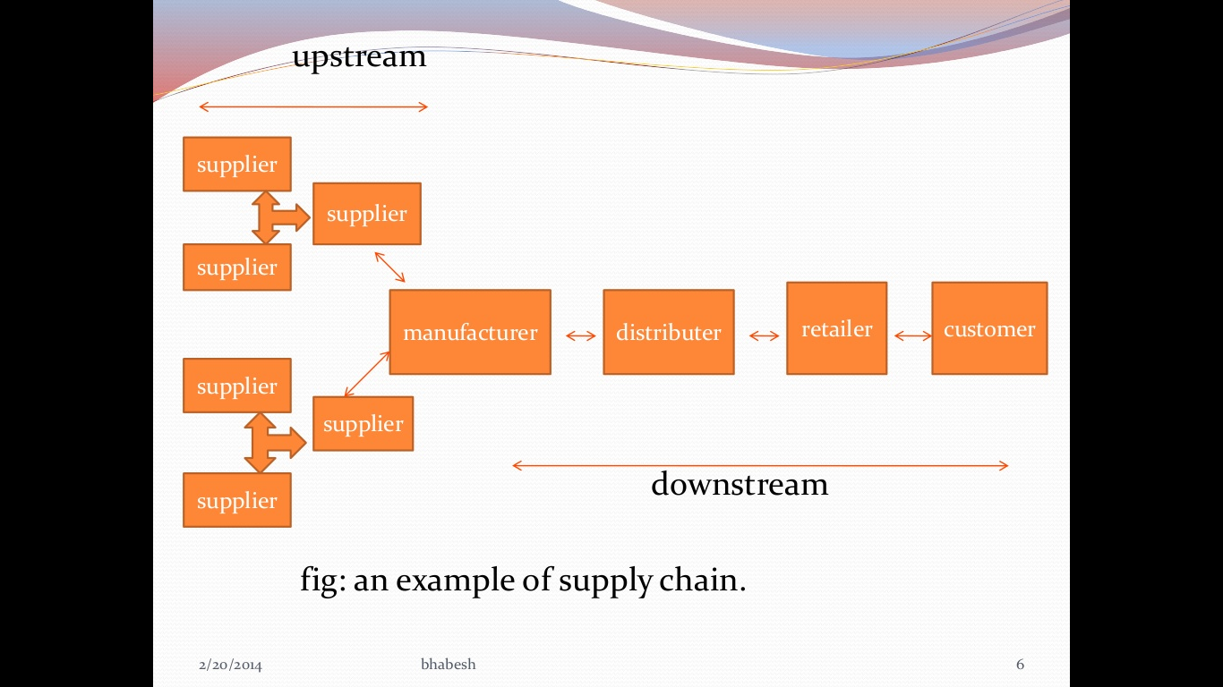

Slide 10
Types of Supply Chain
If the company is a traditional one, it will produce items that will be stored in warehouses and other locations, making the supply chain more complex. If the company uses a make-to-order business model, there will be no need for storing finished products, but there will be need to store raw materials and components. Therefore, it is clear that supply chains depend on the nature of the company. The following four types are very common.
1. Integrated Make-to-Stock Model: The integrated make-to-stock supply chain model focuses on tracking customer demand in real time, so that the production process can restock the finished goods inventory efficiently. Through application of such a system, the organization can receive real-time demand information that can be used to develop and modify production plans and schedules.
An example is Starbucks Coffee (starbucks.com) which uses several distribution channels, not only selling coffee drinks to consumers, but also selling beans and ground coffee to businesses such as airlines, supermarkets, department stores, and ice-cream makers. Sales are also done through direct mail, including the Internet. Starbucks is successfully integrating all sources of demand and matching it with the supply by using Oracle’s automated information system for manufacturing (called GEMMS). The system does distribution planning, manufacturing scheduling, and inventory control (using MRP). The coordination of supply with multiple distribution channels requires timely and accurate information flow about demand, inventories, storage capacity, transportation scheduling, and more. The information systems are critical in doing all the above with maximum effectiveness and reasonable cost. Finally, Starbucks must work closely with hundreds of business partners.

Slide 11
Contd.
2. Build-to-Order Model:
In this model a company begins assembly of the customer’s order almost immediately upon receipt of the order. This requires careful management of the component inventories and delivery of needed supplies along the supply chain. A solution to this potential inventory problem is to utilize many common components across several production lines and in several locations.
One of the primary benefits of this type of supply chain model is the perception that each customer is receiving a personalized product. In addition, the customer is receiving it rapidly. This type of supply chain model supports the concept of mass customization.
Example: Dell Computer is best known for its application of the build-to-order model.

Slide 12
Contd.
3. Continuous Replenishment Model:
The idea of the continuous replenishment supply chain model is to constantly replenish the inventory by working closely with suppliers and/or intermediaries. Real-time information about demand changes is required in order for the production process to maintain the desired replenishment schedules and levels.
This model is most applicable to environments with stable demand patterns, as is usually the case with distribution of prescription medicine.

Slide 13
Contd.
4. Channel Assembly Model:
In this model, the parts of the product are gathered and assembled as the product moves through the distribution channel. This is accomplished through strategic alliances with third-party logistics (3PL) firms. These services sometimes involve either physical assembly of a product at a 3PL facility or collection of finished components for delivery to the customer.
For example, a computer company would have items such as the monitor shipped directly from its vendor to a 3PL facility (e.g., one run by Federal Express or UPS). The customer’s computer order would therefore only come together once all items were placed on a vehicle for delivery. A channel assembly may have low or zero inventories, and it is popular in the computer technology industry.

Slide 14
Key Business Processes
Customer relationship management:
Allows companies to prioritize their marketing focus on different customer groups according to each group’s long-term value to the company or supply chain.
Customer service management:
Presents a multi-company, unified response system to the customer whenever complaints, concerns, questions, or comments are voiced
Demand management:
Seeks to align supply and demand throughout the supply chain by anticipating customer requirements at each level and create demand-related plans of action prior to actual customer purchasing behavior
Order or distribution fulfillment:
a highly integrated process, often requiring persons from multiple companies and multiple functions to come together and coordinate to create customer satisfaction at a given place and time

Slide 15
Contd.
Manufacturing flow management:
Concerned with ensuring that firms in the supply chain have the needed resources to manufacture with flexibility and to move products through a multi-stage production process
Supplier relationship management:
Closely related to the manufacturing flow management process and contains several characteristics that parallel the customer relationship management process
Product development and commercialization:
Includes the group activities that facilitates the joint development and marketing of new offerings among a group of supply chain partner firms
Returns management:
Enables firms to manage volumes of returned product efficiently, while minimizing returns-related costs and maximizing the value of the returned assets to the firms in the supply chain

Slide 16
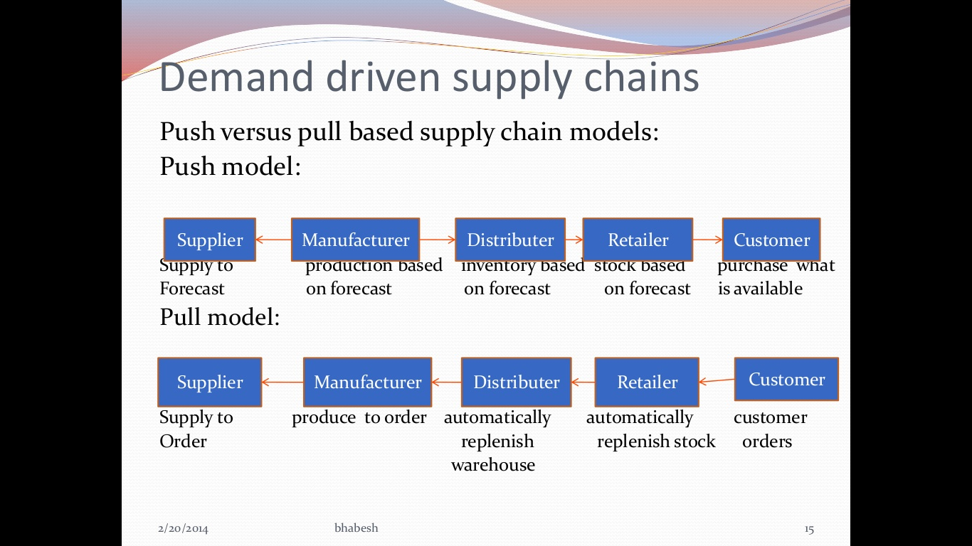

Slide 17
Variability in SCM
Demand Variability:
Even the most sophisticated demand forecasting tools often fails to anticipate the demand.
Process Variability:
Unexpected staff absence
wrong inventory forecast
Supply Variability:
Late delivery from supplier

Slide 18
Levels of Decisions in the Supply Chain
In order to make sure that the above supply chain is running smoothly and also to ensure maximum customer satisfaction at the lowest possible cost, organizations adopt supply chain management processes and various technologies to assist in these processes.
There are three levels of activities/decision in Supply Chain Management with that different departments of an organization focus on to achieve the smooth running of the supply chain. They are:
Strategic Decision
Tactical Decision
Operational Decision

Slide 19
Contd.
Strategic - At this level, senior management is involved in the supply chain process and makes decisions that concern the entire organization and “what processes each stage will perform?”. Every effective supply chain strategy begins with solid long-term decision-making. The strategic level lays the groundwork for the entire supply chain process, from beginning to end, and is an essential part of supply chain management. Decisions made at this level include the size and site of the production area, the collaborations with suppliers, and the type of that product that is going to be manufactured and so forth.
Decisions addressed at this level include:
Designing the SCM to meet the organizational goal
Recognize business trend, priorities
Choosing the site and purpose of business facilities
Creating a network of reliable suppliers, transporters, and logistics handlers
Long-term improvements and innovations to meet client demands
Inventory and product management throughout its life cycle
Define the role of IT programs and systems to make the process more effective
Involved top level management

Slide 20
Contd.
Tactical - “ How to achieve the strategic goals?” ,Tactical level of activity focuses on achieving lowest costs for running the supply chain. Businesses make mid-term decisions involving the supply chain at the tactical level. At the strategy level, general planning begins, but processes are actually defined at the tactical level. Tactical decisions play a big role in controlling costs and minimizing risks. At this level, the focus is on customer demands and achieving the best end value. Some of the ways this is done is by creating a purchasing plan with a preferred suppliers and working with transportation companies for cost effective transport.
Common concerns include:
Procurement contracts for necessary materials and services
Mid term planning and mid level management involved
Production schedules and guidelines to meet quality, safety, and quantity standards
Transportation and warehousing solutions, including outsourcing and third-party options
Inventory logistics and policies, including storage and end-product distribution
Adopting best practices in comparison to competitors

Slide 21
Contd.
Operational - At the operational level, activity decisions are made on a day-to-day basis and these decisions affect how the product distribute along the supply chain. Some of the decisions taken at this level include taking customer orders and the movement of goods from the warehouse to the point of consumption. To keep the supply chain active, this level played an important role but plans and decisions for real execution is made at the above levels. The mistake that many companies make is to jump straight into operational management without focusing on the strategy and tactical levels. Effective operational level processes are the result of strong strategic and tactical planning.
Some aspects of operational level management are:
Daily and weekly forecasting to figure out and satisfy demand(Short term planning)
Production operations, including scheduling and detailed management of goods-in-process
Monitoring logistics activity for contract and order fulfillment
Settling damages or losses with suppliers, vendors, and clients
Managing incoming and outgoing materials and products, as well as on-hand inventories
Goal implemented in such a way to be effectively implemented at operational level

Slide 22
Benefits of Supply Chain Management
Lower inventory, transportation, warehousing, and packaging costs
Greater supply chain flexibility and eliminated rush(unplanned) activity
Improved customer services
Minimizes delays
Reduces the uncertainty of chain
Higher revenues
Increased performance and profitability

Slide 23
Critical factors that can affect Supply Chain Management
Environmental uncertainty
Company environment
Government Issues
Uncertainty aspects from overseas
Information technology
Communication tools
Planning tools(ERP, MRP)
Supply chain relationships(with customer & supplier)
Supply Chain Management performance(logistics, timely delivery, supplier market, material sourcing)
Marketing Strategy
Customer satisfaction(services)

Slide 24
Cross Functional Linkage
In any business or organization, all functions are interlinked and connected to each other and are often overlapping. Some key aspects like supply chain management, logistics and customers link form the backbone of the business delivery function.
Role of Finance in SCM
Role of IT in SCM
Role of R & D in SCM
Role of Production in SCM
Role of Marketing in SCM
Role of Sales in SCM
Role of Forecasting in SCM
Role of Customer Service in SCM
Role of Inter-Functional coordination in SCM
Role of Inter-Corporate in SCM
Role of Performance measurement in SCM

Slide 25
Why Is Performance Measurement Important?
Measurement is important, as it affects behavior that impacts supply chain performance. As such, performance measurement provides the means by which a company can assess whether its supply chain has improved or degraded. So these below points should be consider at the time of performance measurement:
Measurements are important to directly controlling behavior and indirectly to performance .
Identification of key measurements which will help in keeping a company on track towards achieving its supply chain improvement objectives.
Picking the wrong measures and leaving out important ones could lead to supply chain performance degradation.
Supply chain performance measures can be classified broadly into two categories qualitative measures (such as customer satisfaction and product quality) and quantitative measures (such as order-to-delivery lead time, supply chain response time, flexibility, resource utilization, delivery performance, etc.).

Slide 26
Metrics for performance evaluation
Order lead-time
The total order cycle time, which is called “order lead time ”, refers to the time, which elapses between the receipt of the customer’s order and the delivery of the goods.
Total order cycle time = Order entry time (through forecast/direct order from the customer) + Order planning time (Design + Communication + Scheduling time) + Order sourcing, assembly and follow up time + Finished goods delivery time.
The customer order path
The path that order traverse is another important measure whereby the time spent in different routes and non-value adding activities can be identified, and suitable steps can be taken to eliminate them.
Supply chain partnership and related metrics
An efficient and effective performance evaluation of buyer and/or suppliers is not just enough; the extent of partnership that exists between them needs to be evaluated and improved, as well.
Measuring customer service and satisfaction
This measurement is aimed to integrate the customer specification in design, set the dimensions of quality and the feedback for the control process. They contain product/service flexibility, customer query time, and post-transaction service.
Order entry
The order entry determines the way and the extent to which the customer specifications/requirements are converted into useful information, and are passed down along the supply chain.

Slide 27
Contd.
Production level measures and metrics
As an important part of SCM, the performance of the production process also needs to be measured, managed, improved, and suitable metrics for it should be established. This category consists of range of product and services, capacity utilization, and effectiveness of scheduling techniques.
Performance evaluation of delivery link
These measures are designed to evaluate the performance of delivery and distribution cost in supply chain. The typical measures for delivery performance evaluation are lead-time reduction in the delivery process, on-time delivery, distribution mode, the delivery channel, vehicle scheduling, and warehouse location, the percentage of goods in transit, quality of information exchanged during delivery, number of faultless notes invoiced, flexibility of delivery systems to meet particular customer needs
Supply chain finance and logistics cost
Determining the total logistics cost can assess the financial performance of a supply chain such as assets cost, return on investment, and total inventory cost.

Slide 28
Inventory Management
Inventory: Goods or material( such as, raw materials, and finished and unfinished products) which have not yet been sold and hold by the company with intent to sell or transform into a more valuable form. Or
Inventory is an idle stock of physical goods that contain economic value, and are held in various forms by an organization in its custody awaiting packing, processing, transformation, use or sale in a future point of time.
Inventory management is a very important function that determines the health of the supply chain as well as the impacts the financial health of the balance sheet. Every organization constantly strives to maintain optimum inventory to be able to meet its requirements and avoid over or under inventory that can impact the financial figures.
Inventory management concerns are inventory forecasting, inventory valuation, available physical space for inventory, carrying cost of inventory, future inventory price forecasting, replenishment, lead time for replenishment, returns and defective goods.
There are ways to maintain stock in companies:
a.) Base stock – the portion of inventory that is replenished after it is sold to customers or used in production. b.) Safety stock - the second portion of inventory that is held to protect against the impact of uncertainty.

Slide 29
Contd.
Types of inventory:
Raw materials - materials that will be use in making a product.
Work in process - materials that have begun their transformation to finished goods.
Finished goods - goods ready for sale to customers.
Goods for resale - returned goods that can be used in business.
Stocks in transit- product have been left the factory but not arrived at customer’s place.
Reasons to keep inventory:
To fill time lag in SCM or in business processes
To complete seasonal demand
Bulk purchasing is economic of scale
An increase in the value of an asset over time
Buffering the product in case of uncertainty
Costs associated with inventory:
Ordering cost
Setup cost
Holding Cost
Shortage Cost

Slide 30
E-Marketplace:
The e-marketplace or electronic market place is a virtual marketplace where buyers and suppliers meet to exchange information about product and service offers, and to negotiate and carry out business transactions.
OR an Internet-based environment that brings together business-to-business(B2B) buyers and sellers so that they can trade more efficiently products online.
E-Marketplaces have been launched by private firms and industry consortia. For example, Cisco and Dell run their own private e-Marketplaces to sell their products. An E-marketplace, can be seen as a Website or a set of linked sites of common interest to specific types of participants. E-marketplace helps enterprises to do business in several ways, which are described below: It help buyers when they face a large number of suppliers, it becomes difficult to reach these suppliers off-line or to contact them. In this case, E-marketplaces usually provide the possibility of a parametric search across suppliers and in-depth product information. In this way, they help customers to make an effective cost-quality analysis and to choose a product, which suits them the best. It helps in buying and selling products that are available in low volume and for changing the product when it is in warranty. In this case, an E-marketplace usually organizes an on-line spot exchange for its members and helps to build market liquidity.
Examples of some online marketplaces are Amazon.com, Alibaba, eBay, Flipkart, Snapdeal.

Slide 31
E-Procurement
Procurement cycle starts from raising the requirements of an item and ends to the settlement or receive of the product. it includes activities like request, place order, purchase approval, product receive, and pay. Procurement little bit behaves differently after introducing electronic media with above phases.
E-Procurement refers to web-based procurement networks in which one or more companies contacted to their suppliers at the lowest costs possible and performing procurement .
E-procurement can be possible for B2B, B2C and B2G sale. It consists of indent management(workflow to prepare tenders), e-Auction, vender management, order status, shipment notification, e-invoicing and e-payment.
Benefits of e-Procurement
A virtual elimination of paperwork and paperwork handling
A reduction in the time between need recognition and the release and receipt of an order
Improved communication both within the company and with suppliers
A reduction in errors
Lower overhead costs in the purchasing area
Purchasing personnel spend less time on processing of purchase orders and invoices, and more time on strategic value-added purchasing activities

Slide 32
E-Logistics
Logistics is the management of the flow of things between the point of origin and the point of consumption in order to meet requirements of customers or corporations. The resources managed in logistics can include physical items. The logistics of physical items usually involves the integration of information flow, which is material handling, production, packaging, inventory, transportation, warehousing, and often security.
E-Logistics is applying the same process as logistics such as planning, implementing and controlling procedures for the efficient and effective transportation and storage of goods including services and related information from the point of origin to the point of consumption for the purpose of conforming to customer requirements and includes inbound, outbound, internal and external movements with the help electronic media.
It Includes some activities:
Inbound logistics
Outbound logistics
Procurement logistics
Distribution logistics
Disposal logistics
Production logistics
Green logistics
Reverse logistics
Asset control logistics

Slide 33
ERP(Enterprise Resource Planning)
An ERP system is a business management software that allows an organization to integrate all functions across a company to a single computer system that can serve all those functions’ specific needs.
“Integration” is the key word for ERP implementation. It may also integrate key customers and suppliers as part of the enterprise’s operation.
It provides integrated database and custom-designed report systems.
It adopts a set of “best practices” for carrying out all business processes.
There are two main ERP applications :
Core Application(Online Transaction Processing(OLTP)): Support the day-to-day operational activities of the business.
Business Application(Online Analytical Processing(OLAP)):Decision support tool for management-critical tasks through analytical investigation of complex data associations

Slide 34
Business Enterprise
Products
Materials
Order Entry
System
Manufacturing
and
Distribution
System
Procurement
System
Customer
Supplier
Orders
Purchases
Customer
Sales
Account Rec
Production
Scheduling
Shipping
Vendor
Accts Pay
Inventory
Customer Database
Manufacturing Database
Procurement Database
Traditional Information System with Closed Database Architecture

Slide 35
ERP System
Business Enterprise
Data Warehouse
Legacy
Systems
ERP System
On-Line Analytical Processing
(OLAP)
Bolt-On Applications
(Industry Specific Functions)
Customers
Suppliers
Core Functions [On-Line Transaction Processing (OLTP)]
Sales
&
Distribution
Business
Planning
Shop Floor
Control
Logistics
Operational Database
Customers, Production,
Vendor, Inventory, etc.

Slide 36
Major Reasons for Adopting ERP
ERP Implementation Approaches
The big bang – install a single ERP system across the entire organization
Franchising – Independent ERP systems are installed in different units linked by common processes, e.g., bookkeeping.
Slam dunk – install one or several ERP modules for phased implementation of key business processes.
Integrate financial, sales information
Integrate customer order information
Standardize and speed up operations processes
Reduce inventory
Standardize Human Resources information

Slide 37
Major Phases of ERP Implementation
Initiation – develop business case, project scope, and implementation strategy
Planning – establish implementation team, determine goals and objectives, establish metrics
Analysis and process design – analyze and improve existing processes, map new processes to be adopted by the system
Realization – install a base system, customization, and test the system
Transition – replace the formal system with the new system, data conversion
Operation – monitor and improve system performance, provide continued training and technical support

Slide 38
Potential Benefits of ERP
Internal Benefits
Integration of a single source of data
Common data definition
A real-time system
Increased productivity
Reduced operating costs
Improved internal communication
Foundation for future improvement
External Benefits
Improved customer service and order fulfillment
Improved communication with suppliers and customers
Enhanced competitive position
Increased sales and profits

Slide 39
Major Challenges to ERP Implementation
Limitations of ERP technical capabilities
Inconsistency with existing business processes
Costs - implementation (hardware, software, training, consulting) and maintenance
Impact on organizational structure (front office vs. back office, product lines, etc.)
Changes in employee responsibilities

Slide 40
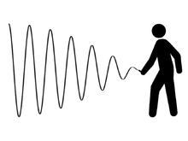
Bullwhip Effect
The bullwhip effect is an observed phenomenon in forecast-driven distribution channels. It refers to a trend of larger and larger swings in inventory in response to changes in customer demand, as one looks at firms further back in the supply chain for a product.
Demand variability increases as one moves up the supply chain away from the retail customer, and small changes in consumer demand can result in large variations in orders placed upstream. Eventually, the network can oscillate in very large swings as each organization in the supply chain seeks to solve the problem from its own perspective. This phenomenon is known as the bullwhip effect and has been observed across most industries, resulting in increased cost and poorer service.
Reasons for Bullwhip effect: Sources of variability can be demand variability, quality problems, strikes, plant fires, etc. Variability coupled with time delays in the transmission of information up the supply chain and time delays in manufacturing and shipping goods down the supply chain create the bullwhip effect.
Solution : The bullwhip effect is the phenomenon of orders and inventories getting progressively larger (more variable) moving backwards through the supply chain.
How then can we cope with the bullwhip effect?
Centralizing demand information occurs when customer demand information is available to all members of the supply chain. This information can be used to better predict what products and volumes are needed and when they are needed such that manufacturers can better plan for production. However, even though centralizing demand information can reduce the bullwhip effect, it will not eliminate it. Therefore, other methods are needed to cope with the bullwhip effect.

Slide 41
Symptoms of the Bullwhip Effect
Excessive Inventory
Poor Forecasts
Insufficient and/or excessive capacities
Unavailable Products
Long Backlogs
Costs for Expedited Shipments and
Overtime

